Slide 1

Data Science 1

Slide 2
Setting the scene…
Across all disciplines, there is a need for more data scientists
Data science is being touted as a ‘hot’ career choice for academics and practitioners alike!
A recognized need for the use of power technological tools to explore the vast amounts of digital material
Data-analysis methods are not just being employed in natural sciences, but also in law, economics, sociology, political sciences, history, and arts

Slide 3
What is Data Science?
“The science of learning from data; it studies the methods involved in the analysis and processing of data and proposes technology to improve methods in an evidence-based manner.”
(David Donoho, 2015)
The Beginning:
1962 - John Tukey in ‘The Future of Data Analysis’ introduced a new field, the result of 4 forces:
The formal theories of statistics
Accelerating developments in computers and display devices
The challenge of more and ever larger bodies of data
The emphasis on quantification in an ever wider variety of disciplines
Notes:
David Donoho is a professor of statistics at Stanford University. His undergraduate thesis advisor was John Tukey, who can be seen as the grandfather of Data Science.

Slide 4
What is Data Science?
2001 – William Cleveland in ‘Data Science: An Action Plan for Expanding the Technical Areas of the field of Statistics’

Slide 5
What is Data Science?
2001 – Leo Breiman in ‘Statistical Modeling: The Two Cultures’:
There are two goals in analyzing data:
Information Extraction
(Inference)
Prediction
Associating the response variables to the input variables
98% of academic statisticians
Predicting what the responses are going to be to future input variables
2% of academic
statisticians
Notes:
Add examples of inference and of prediction
Breiman says that users of data split into two cultures, based on their primary allegiance one or the other of these goals
Predictive modeling as something that developed in computer science departments with machine learning at its epicenter; it only cares about the accuracy of prediction made by different algorithms, it doesn’t care that much about the underlying mechanisms generating the data

Slide 6

What is Data Science?
COMMON TASK FRAMEWORK
A publicly available training dataset
Competitors whose is to derive a predictive model from the training data
A testing dataset on which the predictive models are objectively evaluated
HACKATHONS
Notes:
The Netflix Challenge: the common task was to predict Netflix user movie selections based on customer history data from Netflix; the winning team go 1M$
Error rates decline each year, progress usually comes from many small improvements; a change of 1% can be a reason to break out the champagne

Slide 7
The Full Scope of Data Science
Data Exploration and Preparation
Data Representation and Transformation
Computing with Data
Data Modeling
Data Visualization and Presentation
Science about Data Science

Slide 8


Data Exploration and Preparation
80% of each data scientific project is…

Slide 9
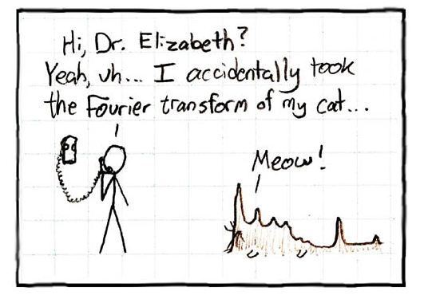
Data Representation and Transformation
gizmodo.com

Slide 10


Computing with Data

Slide 11
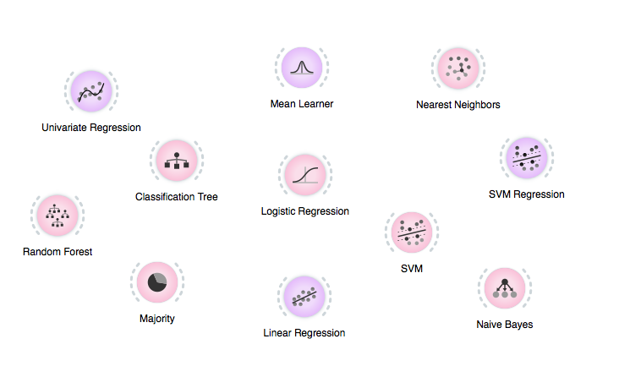
Data Modeling

Slide 12
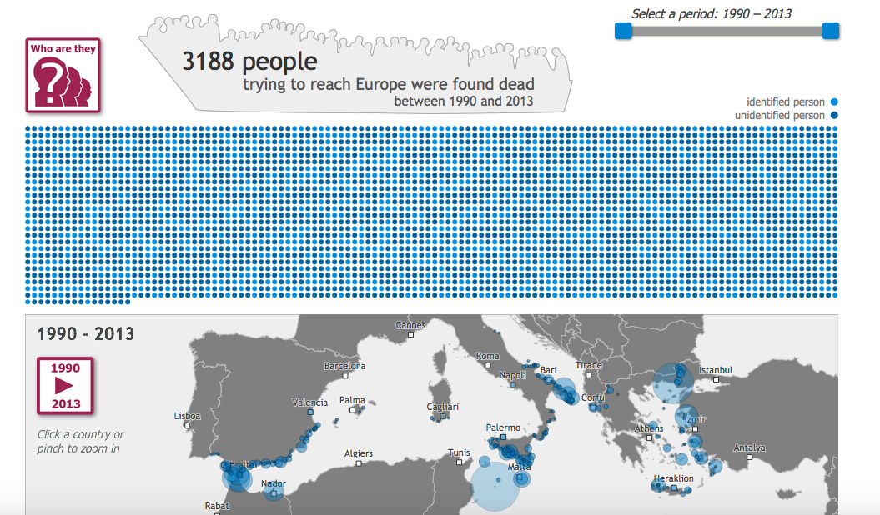
Data Visualization and Presentation
Mirjam Leunissen (Dutch Data Design)
for www.boarderdeaths.org

Slide 13
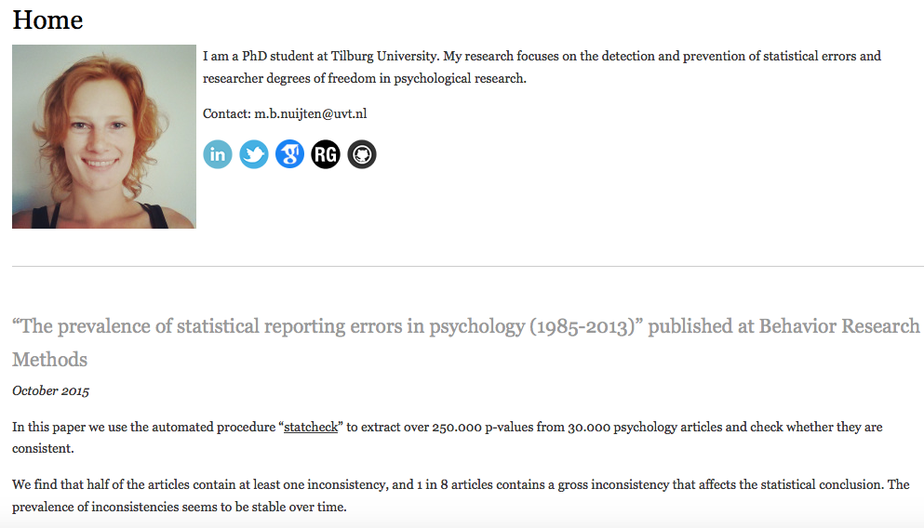
Science about Data Science

Slide 14
Summary
Data scientists use both ‘academic’ statistics for inference and machine learning for predictive modeling;
An inherent part of their job is that they do not work with carefully curated data but with large messy data sets; therefore, a substantial amount of time is devoted to data cleaning and preparation;
“From causation to correlation”: The quest for the best theory (hypothesis testing) has been replaced by data analysis (Let the data speak!) and predictive modeling.

Slide 15
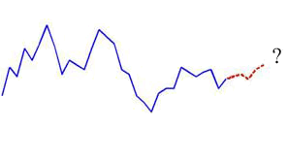
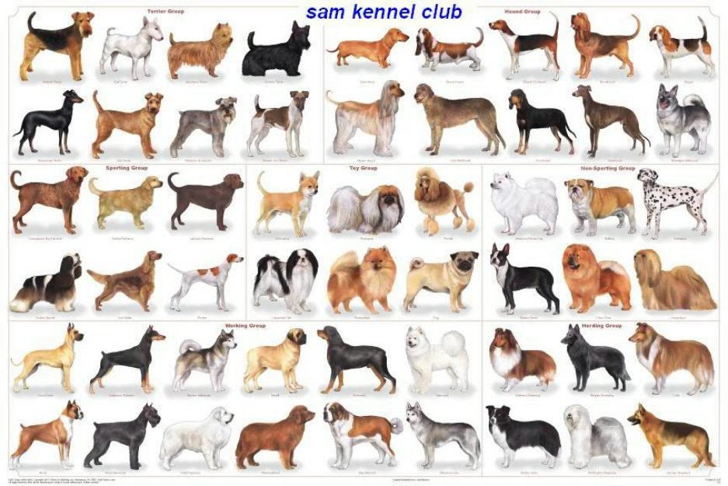
Typical Data Science Tasks
Prediction
Recognizing previously unseen things

Slide 16

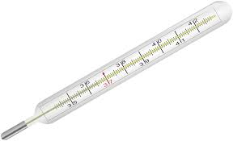
Two Main Types of Prediction
Classification
Discrete output
E.g. color, gender, truth, inequalities, class membership, ...
Regression
Continuous output
E.g. temperature, salary, length, pressure, …
“YES”
FRUIT?
“36.5”
TEMPERATURE?

Slide 17

Binary Classification: DOG/NO DOG?

Slide 18
Binary Classification: DOG/CAT?

Slide 19
Regression: AGE?

Slide 20
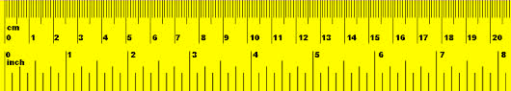
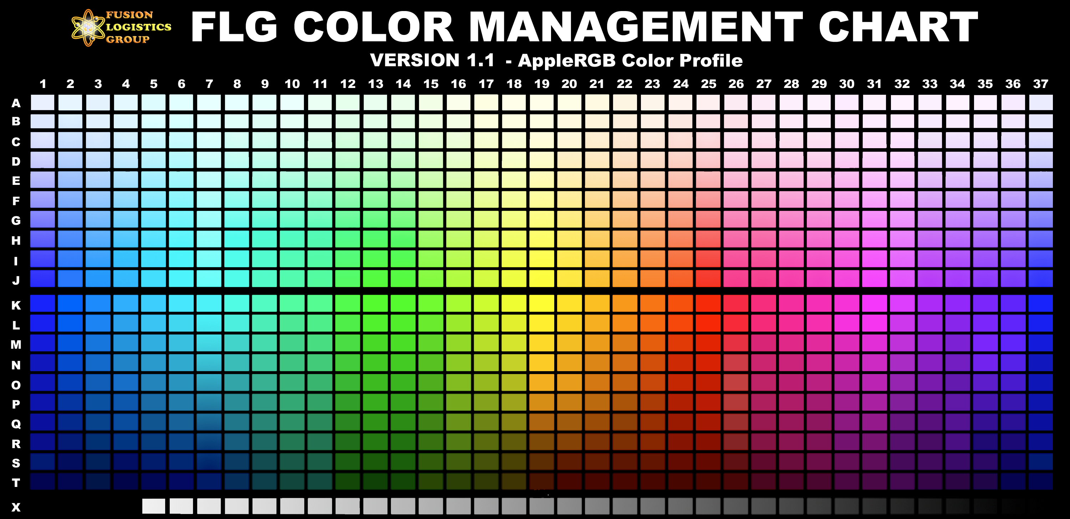
Data Science Basic Concepts
CONCEPT
EXAMPLE
instances
labels
features
feature values
feature vector
“Popov”
“dog” or “4 years”
color, height, furriness
“white”, “0.3m”, “high”
(“white”,”0.3m”,”high”)

Slide 21


Correlation
Popov
cuteness
furriness

Slide 22
Correlation
furriness "predicts" cuteness
correlation may allow for prediction

Slide 23
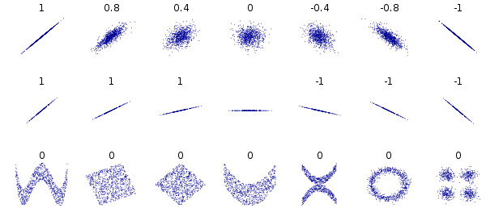
Pearson’s correlation coefficient a.k.a. “Pearson’s r”

Slide 24

Big Data Hype: “The End of Theory”
Finding correlations in large data collections to make (scientific) discoveries.
“Theories not necessary anymore”
CORRELATION DOES NOT IMPLY CAUSATION

Slide 25
Spurious Correlations

Slide 26
Data Science: Prediction
What is the goal?
What are meaningful features?
How can feature values be obtained?

